Slide 1
Import data from Sq l Server
Import data from Sq l Server

Slide 2
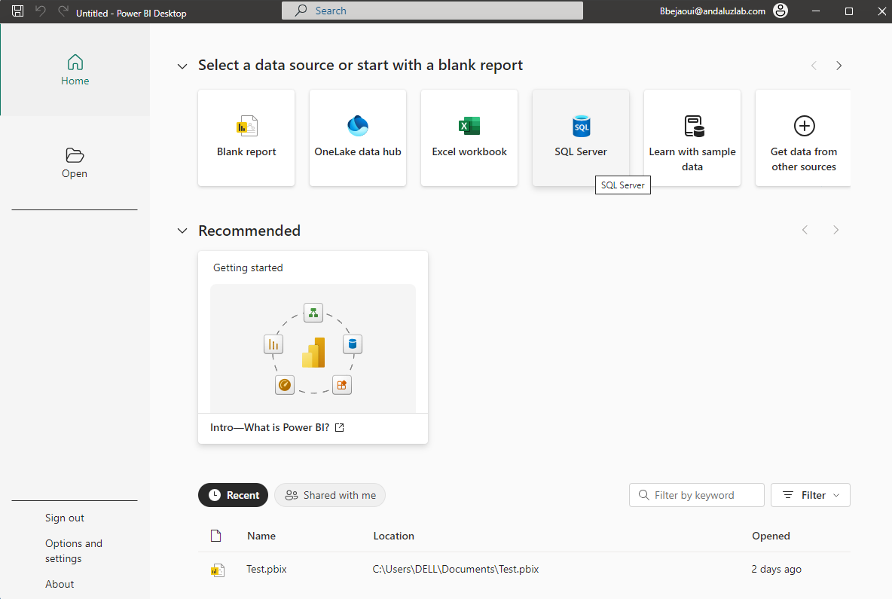
Import SQL Server data
Note: This lab uses SQL Server. This lab uses the SQL Server Sales database whose
the generation script is located in the training resources
\ resources \Sales model\ sales_database_script.sql .
Choose the data source from the More... menu

Slide 3
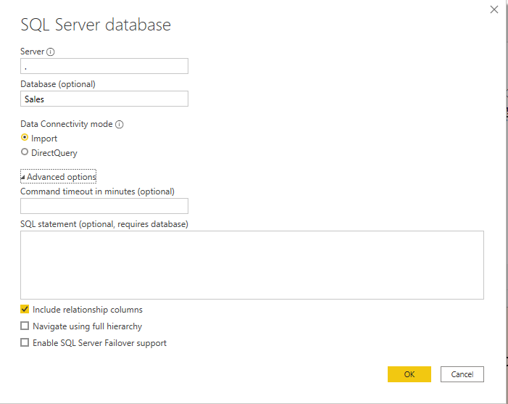
Import SQL Server data
Fill in the server name, connection type fields and leave the inclusion of relationships enabled.
For the rest of the settings, we ignore them at this level and click OK.
1
Server name
2
Name of the base
3
query script

Slide 4
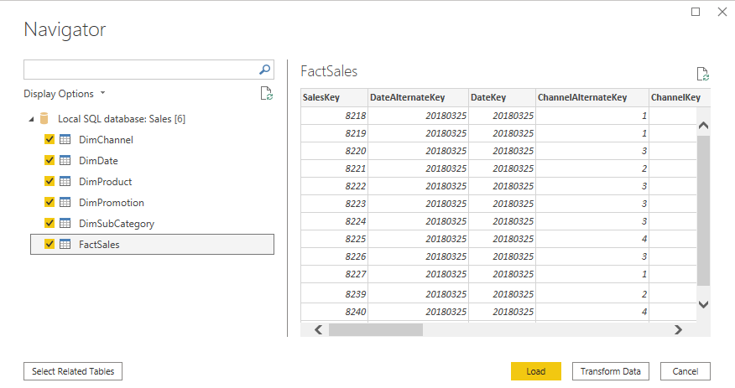
Import SQL Server data
Select the tables to import

Slide 5
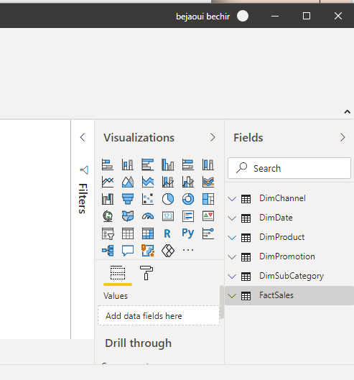
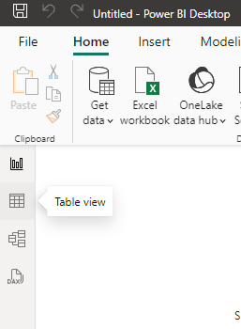
Import SQL Server data
Look at the fields panel on the left and explore the imported data.
2
1

Slide 6
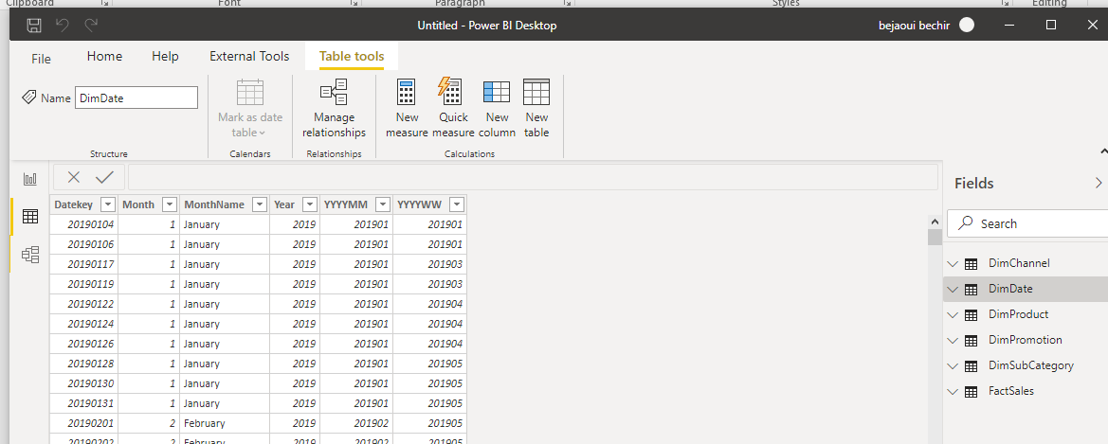
Import SQL Server data
Look at the fields panel on the left and explore the imported data.

Slide 7
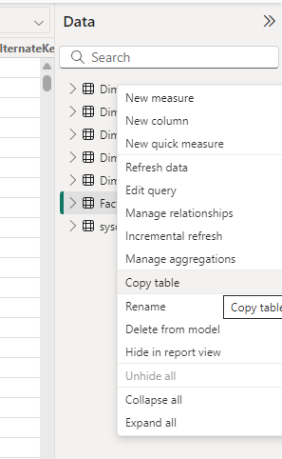
Import SQL Server data
Note that at the top menu level, it is possible to:
Change the table name
Managing relationships
Create a measure
Create a quick measure with the wizard
Create a new calculated column

Slide 8
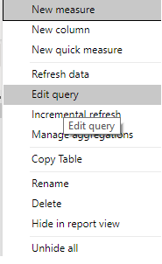
Import SQL Server data
Right-click on DimDate and click Edit Query .

Slide 9
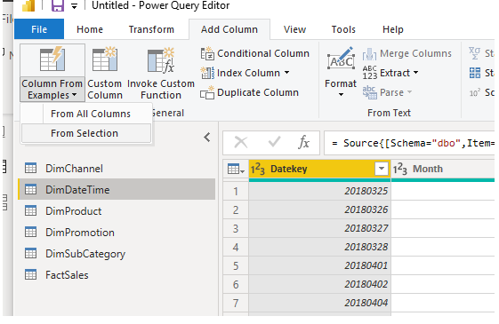
Import SQL Server data
Click the From Sample Column Selection tab and add a column.
1
Add a column
2
Select a custom column
3
Select from a Selection

Slide 10
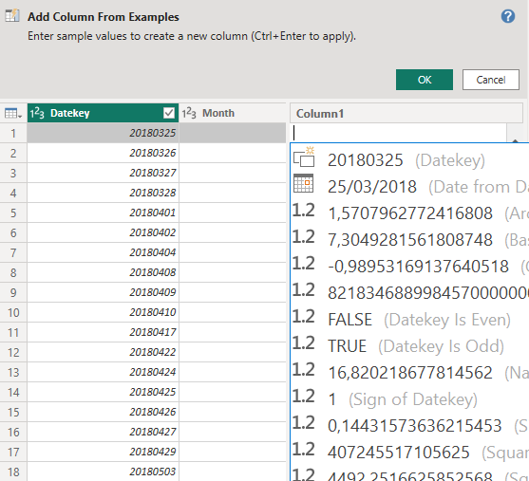
Import SQL Server data
Select the date as an example, press CTRL+ENTER , and then click OK .

Slide 11
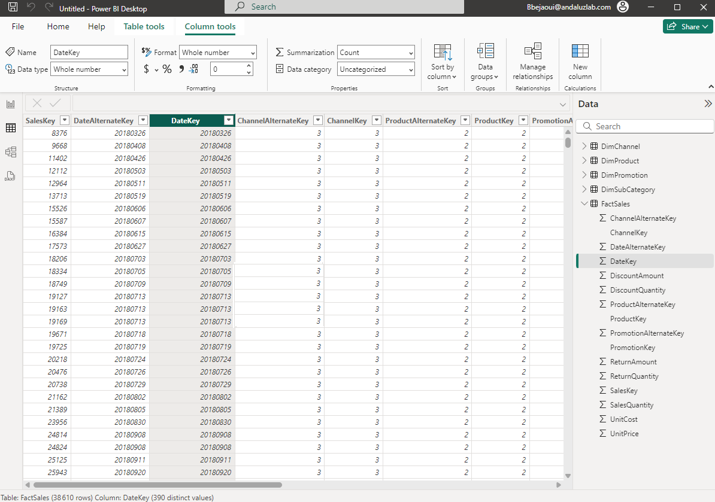
Import SQL Server data
It will be possible to use the FactSales DateKey to generate the entire DimDate table .

Slide 12
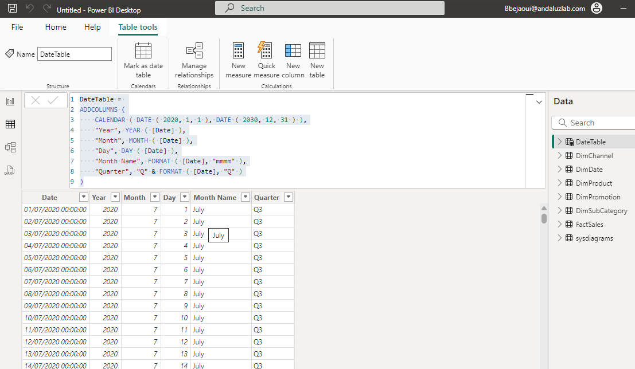
Import SQL Server data
It will be possible to recreate the date table in using the minimum date and the maximum date
from the imported table , for example with DAX.
1
Select Table tools
2
Select New Table
4
Execute the query
3
Define the query to
generate the data
Notes:
Script to generate Date table:
DateTable = ADDCOLUMNS ( CALENDAR ( DATE ( 2020, 1, 1 ), DATE ( 2030, 12, 31 ) ), "Year", YEAR ( [Date] ), "Month", MONTH ( [Date] ), "Day", DAY ( [Date] ), "Month Name", FORMAT ( [Date], " mmmm " ), "Quarter", "Q" & FORMAT ( [Date], "Q" ) )
Example 2:
DimDate =
ADDCOLUMNS (
CALENDAR (
DATE(MIN( FactSales [ DateKey ]), 1, 1),
DATE(MAX( FactSales [ DateKey ]), 12, 31)
),
"Year", YEAR ( [Date] ),
"Month", MONTH ( [Date] ),
"Day", DAY ( [Date] ),
"Month Name", FORMAT ([Date], " mmmm "),
"Quarter", "Q" & FORMAT ( [Date], "Q" )
)

Slide 13
Import SQL Server data
Run this script to generate the DimDate table .
DimDate =
ADDCOLUMNS (
CALENDAR (
DATE ( DIVIDE ( MIN ( FactSales [ DateKey ]), 10000 ),
MOD ( DIVIDE ( MIN ( FactSales [ DateKey ]), 100 ), 100 ),
MOD ( MIN ( FactSales [ DateKey ]), 100 )
),
DATE ( DIVIDE ( MAX ( FactSales [ DateKey ]), 10000 ),
MOD ( DIVIDE ( MAX ( FactSales [ DateKey ]), 100 ), 100 ),
MOD ( MAX ( FactSales [ DateKey ]), 100 )
)
),
" DateKey " , YEAR ([Date]) * 10000 + MONTH ([Date]) * 100 + DAY ([Date]), "Year" , YEAR ([Date]),
"Month" , MONTH ( [Date] ),
"Day" , DAY ( [Date] ),
"Month Name" , FORMAT ([Date], " mmmm " ),
"Quarter" , "Q" & FORMAT ([Date], "Q" )
)

Slide 14
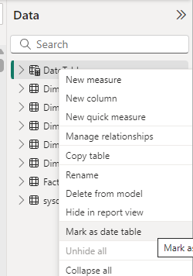
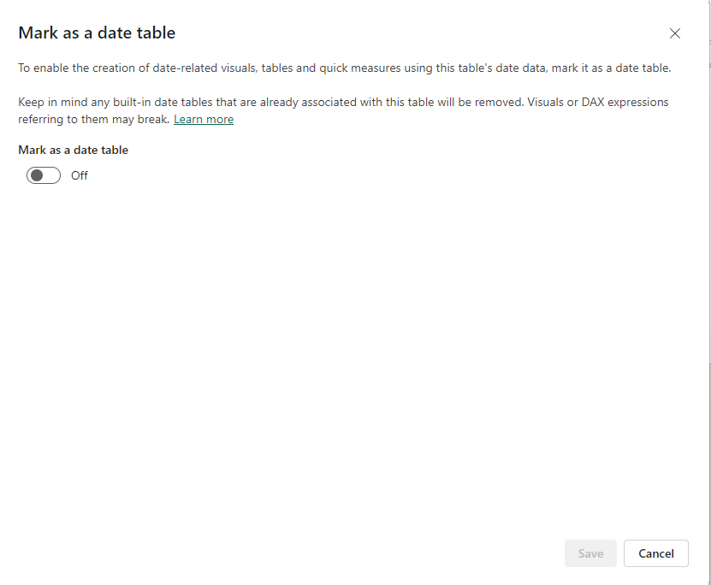
Import SQL Server data
Mark the table as a date table by right-clicking on the table, then selecting Mark as Date Table .

Slide 15
THANKS
THANKS

